Slide 1
Volume 1, Chapter 1

Slide 2
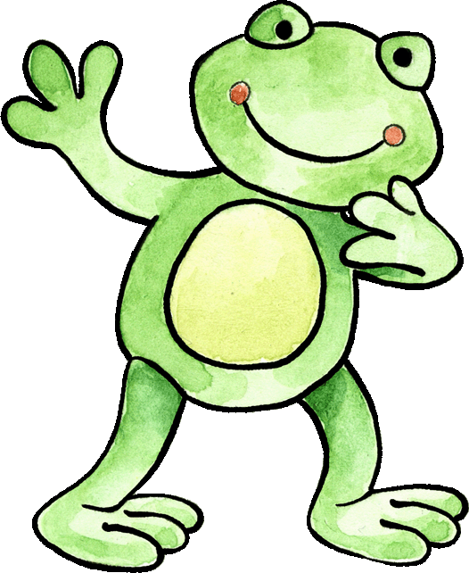
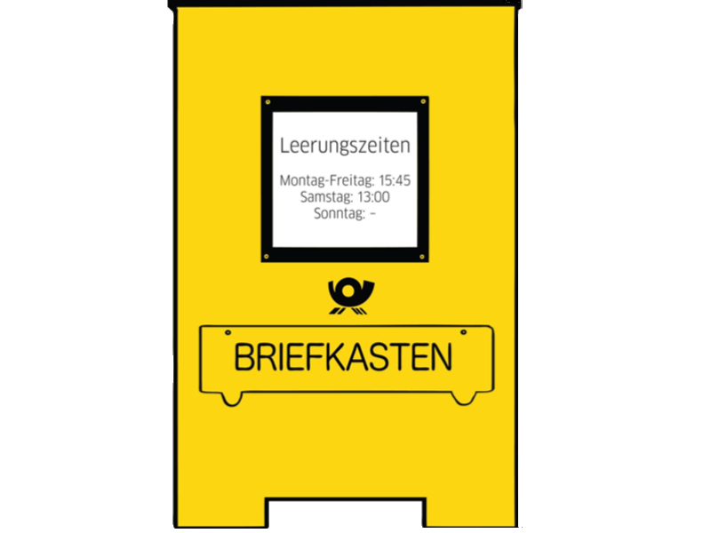
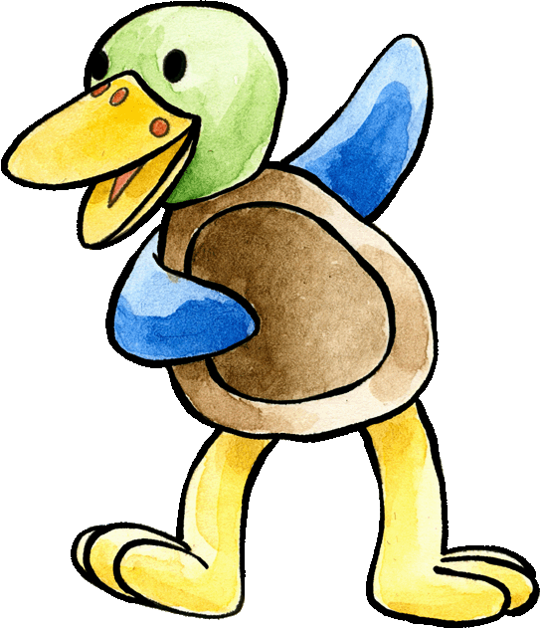
Felix and Franzi have just arrived in England and are greeting each other. Can you guess what they are saying? Start with Felix.
Hallo, Franzi!
Hallo, Kinder!
Guten Tag, Felix!

Slide 3
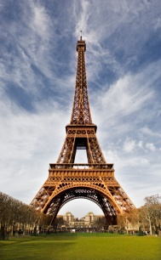

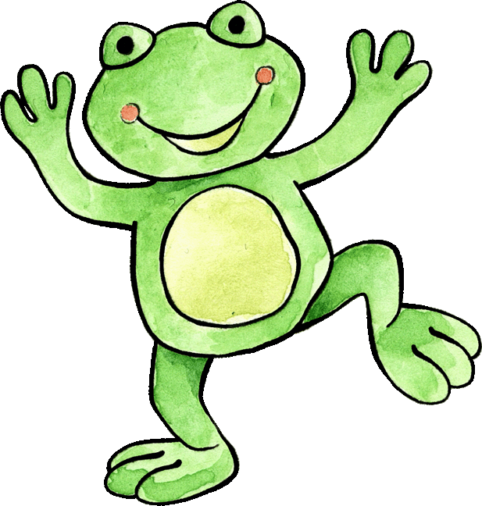
Felix and Franzi would like some things in their letterbox that remind them of home. Which items can you drag into the letterbox that are connected to Germany?

Slide 4


Felix has been messing around with his paint brush. Can you work out which words from the Hello song have been covered in paint?
Hallo Felix. Hallo Franzi
Hallo. Guten Morgen.
Hallo. Guten Tag

Slide 5

All that painting has made Felix hungry. Can you feed him some of his favourite foods as you work out the lyrics of the Goodbye song? Save some food for Franzi by putting it into the bag.
Tschüss Felix. Tschüss Franzi.
Tschüss Freunde.
Auf Wiedersehen. Bis bald.

Slide 6



Can you help Franzi find the 6 greetings hidden behind the stars? Do you know what the extra German words mean?
Guten Morgen
Bis bald
Hallo
Frau
Herr
Auf Wiedersehen
Tschüss
Guten Tag

Slide 7
